Slide 1
Docker CLI (Command Line Interface)
Container 101

Slide 2
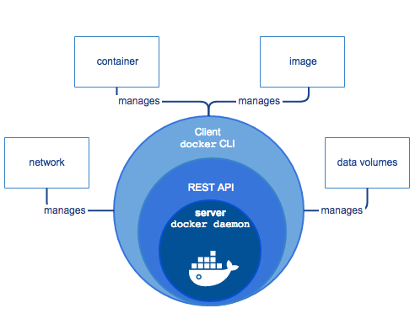

Docker Engine
Docker Daemon
Docker Rest API
Docker CLI

